Slide 1



Project Plan
Dreams LTD

Slide 2

Main Objective:
A business analyst company, Dreams Ltd, has been instructed to identify trends in sales for business intelligence purposes.
It has created a reporting system of ‘items sold’ in order to get an accurate drilldown of the most profitable vs least profitable items.
The analysis will allow the customer company to streamline their stock across the brand, to suit the needs and requirements of the customers in different segments, such as: products, revenue, profit and location.

Slide 3

Setting the Scene
Sales analytics is the mining of data to evaluate the performance of sales business against its goals. It provides valuable insights about the top performing and underperforming products, the problems in selling and market opportunities, sales forecasting, and sales activities that generate revenue.
Why Are Sales KPIs Important?
Key Performance Indicators are metrics used to track the performance of a business against it’s goals. With a clear overview of the business, we can predict their future sales or guide their team members and organization to the right direction.
Identifying the Data We Want to Track
We have tonnes of metrics to track data, but we need to analyse the right sales data to generate meaningful insights that positively impact the marketability of the worst performing items. Furthermore, using trend analysis we are able to find the best-selling or top-selling products with their average profit margins showing marketing predictions for the future.

Slide 4
Understanding the Problem Domain
To assist a customer company that specializes in the sales of Furniture, Technology and Office Supplies to identify trends in sales a dashboard was created showing different inputs of data. The data that was used was gathered from the company in the period between 2014 and 2017 and supplied to us by the Babington Team.
The creation of a dashboard, filtering and slicing data assisted us to analyse and conduct studies of the aspects necessary to identify groups of items that should be removed or replaced by the customer company. It also assists in decision making and controlling the deliveries of products in the different regions of the country by showing profits and projections for the next years.
The continuing use of the dashboard to analyse different datasets will evidently mean that the dashboard’s design, structure and input fields will become more detailed and at the same time more user-friendly to the customer company.

Slide 5



Mastering and managing
Data Understanding

Slide 6

Resume of data:
 | Consumer | Corporate | Home Office | Total of Costumer | Quantity of Items | Revenue | Profit | Profit Ratio
2014
Furniture | £ 85,358.53 | £ 44,867.54 | £ 25,750.23 | 288 | 1601 | £ 155,976.30 | £ 5,446.95 | 3.5%
Office Supplies | £ 85,078.55 | £ 48,928.46 | £ 18,411.40 | 512 | 4573 | £ 152,418.41 | £ 22,578.52 | 13.4%
Technology | £ 94,153.12 | £ 34,396.33 | £ 45,272.80 | 249 | 1381 | £ 173,822.26 | £ 21,373.23 | 16.2%
Total | £ 264,590.20 | £ 128,192.33 | £ 89,434.44 | 598 | 7555 | £ 482,216.96 | £ 49,398.70 | 11.8%
2015
Furniture | £ 94,409.93 | £ 45,418.15 | £ 30,147.22 | 289 | 1772 | £ 169,975.30 | £ 2,874.04 | 4.1%
Office Supplies | £ 79,735.81 | £ 34,823.64 | £ 22,575.76 | 502 | 4702 | £ 137,135.21 | £ 25,056.60 | 12.8%
Technology | £ 92,223.96 | £ 47,670.07 | £ 22,495.55 | 275 | 1486 | £ 162,389.58 | £ 33,410.08 | 16.7%
Total | £ 266,369.69 | £ 127,911.86 | £ 75,218.53 | 573 | 7960 | £ 469,500.08 | £ 61,340.72 | 11.7%
2016
Furniture | £ 100,360.88 | £ 77,261.34 | £ 21,279.21 | 356 | 2193 | £ 198,901.44 | £ 6,959.95 | 3.9%
Office Supplies | £ 86,269.33 | £ 54,231.25 | £ 43,439.40 | 545 | 5946 | £ 183,939.98 | £ 35,061.23 | 16.1%
Technology | £ 110,233.69 | £ 75,613.77 | £ 40,516.72 | 291 | 1698 | £ 226,364.18 | £ 39,773.99 | 13.4%
Total | £ 296,863.90 | £ 207,106.36 | £ 105,235.34 | 640 | 9837 | £ 609,205.60 | £ 81,795.17 | 13.0%
2017
Furniture | £ 110,148.15 | £ 60,365.06 | £ 44,445.94 | 400 | 2426 | £ 214,959.15 | £ 3,402.44 | 4.1%
Office Supplies | £ 113,470.16 | £ 92,685.78 | £ 40,033.82 | 634 | 7671 | £ 246,189.75 | £ 39,773.49 | 12.8%
Technology | £ 108,166.92 | £ 88,464.97 | £ 74,982.98 | 387 | 2361 | £ 271,614.86 | £ 50,651.86 | 16.2%
Total | £ 331,785.22 | £ 241,515.80 | £ 159,462.73 | 695 | 12458 | £ 732,763.75 | £ 93,827.80 | 11.6%
Grand Total | £ 1,159,609.01 | £ 704,726.34 | £ 429,351.04 | 801 | 37810 | £ 2,293,686.40 | £ 286,362.39 | 12.0%

Slide 7
A review of the original Model
Analysing the database provided, with 9975 rows we were able to draw several conclusions from 2014 to 2017, a total of 1,859 items with an enormous difference in value between them.
Regarding the frequency of orders value, we can see the majority sales is between £0 to £300, which means 81% of the database.
The total amount of sales across all regions was £ 2,293,686.40, which is £ 573,421.60 average per year.

Slide 8
A review of the original Model
Observing the graphs on the side we can see that a good part of the profits were negative.
Sales between £0 to £300 corresponds only 23% of the company's total value revenue with a profit margin of 13%. Whereas 82% of these sales were positive, with an average profit of 31%. The other 18% had an average loss of 72%, reaching up to 275% of loss per sale.
Sales above £300, remaining only 19% of total revenue frequency, corresponds to 76% of total value revenue with an average profit margin of 9%. Being that 75% of these sales were positive and had an average profit of 22% and the other 25% of the sales had a loss of 27%, reaching up to 255% of loss per sale.

Slide 9

Data Analysis
In the chart below, we can see the number of orders per department.

Slide 10
Profit
Having an overview of the chart below, we were able to identify which category has the most profit is Office Supplies.

Slide 11

Bestselling Category
We can see in the graph the categories with the more profit percentage. Machines, Appliances, Binders, Bookcases and Tables do not appear on the chart because their averages are negative.

Slide 12

Most popular category
In the chart below we identify the ten least sold items referring to quantity. From here we can assert, whether or not to streamline the portfolio or perform additional marketing.

Slide 13

Least profitable items

Slide 14
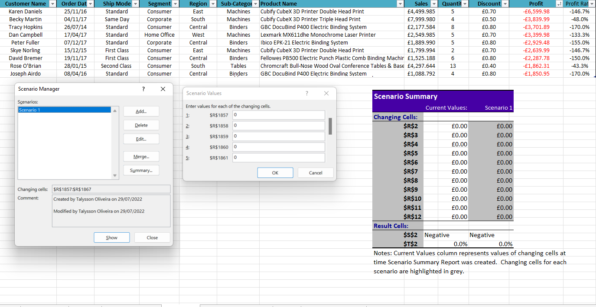
Analysing the ten items with the lowest profit we can filter four sub-categories, that are Tables, Machines, Blinders, and Supplies. We achieved similar a scenario where these items are not in the sales portfolio of the company and considering the profit margin that these items represent of prejudice. What if we substitute or remove them? We can see below the analysis:

Slide 15
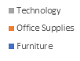
• Scenario Actual
• Profit Ratio
We were able to analyse that removing only these 10 items despite the total sales value decreasing the percentage of profit increases in relation to the current value.
A more in-depth analysis identified 348 sales where the profit was less than the total sales, and 229 items sold for less than the value of the item itself. In other words, the profit value is less than 100% in relation to the sale value.
Altogether, £54,025.04 of loss in addition to the value of the merchandise, i.e., each of these items has more than 100% negative loss.
• Expectations Removing 10 items
• Profit Ratio
Chart Profit before changes

Slide 16
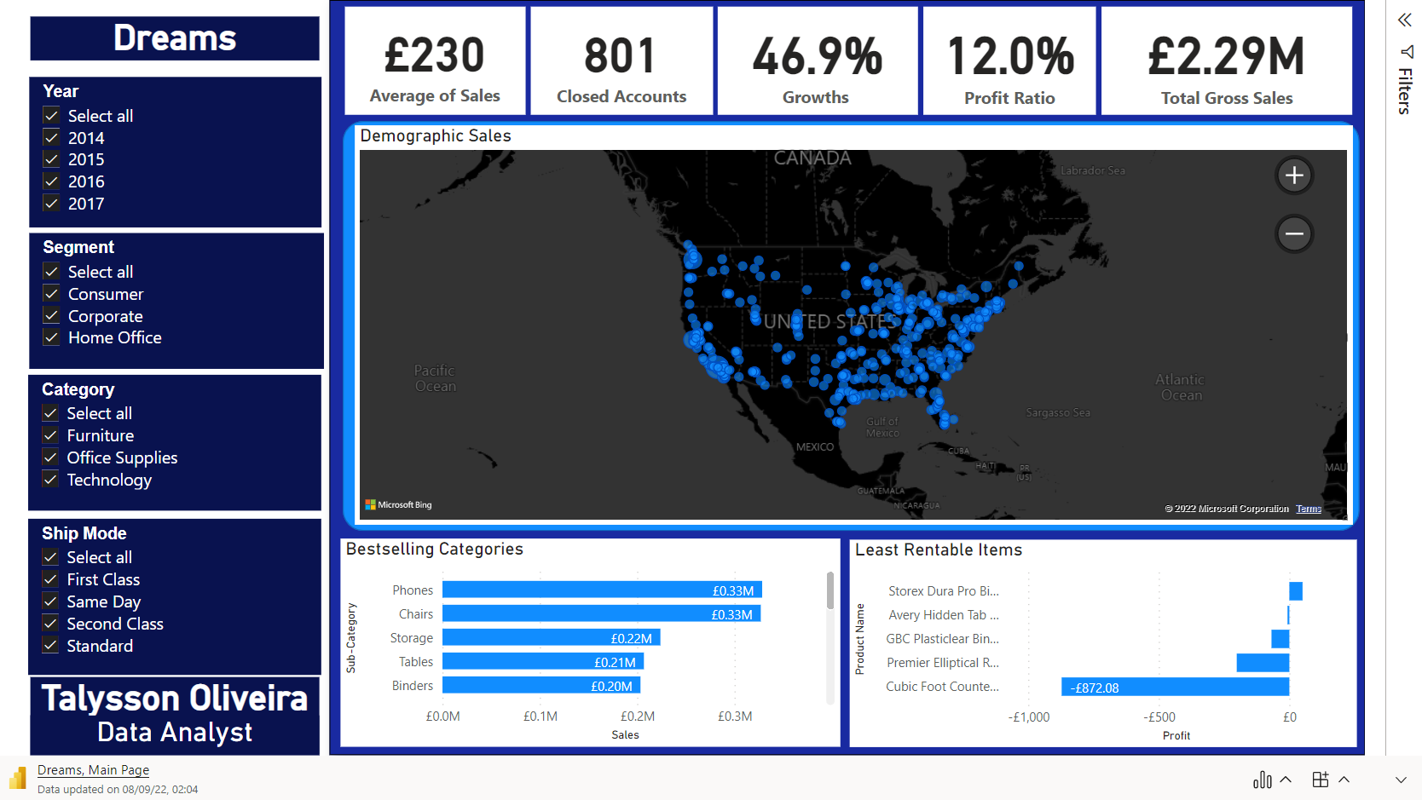

Slide 17
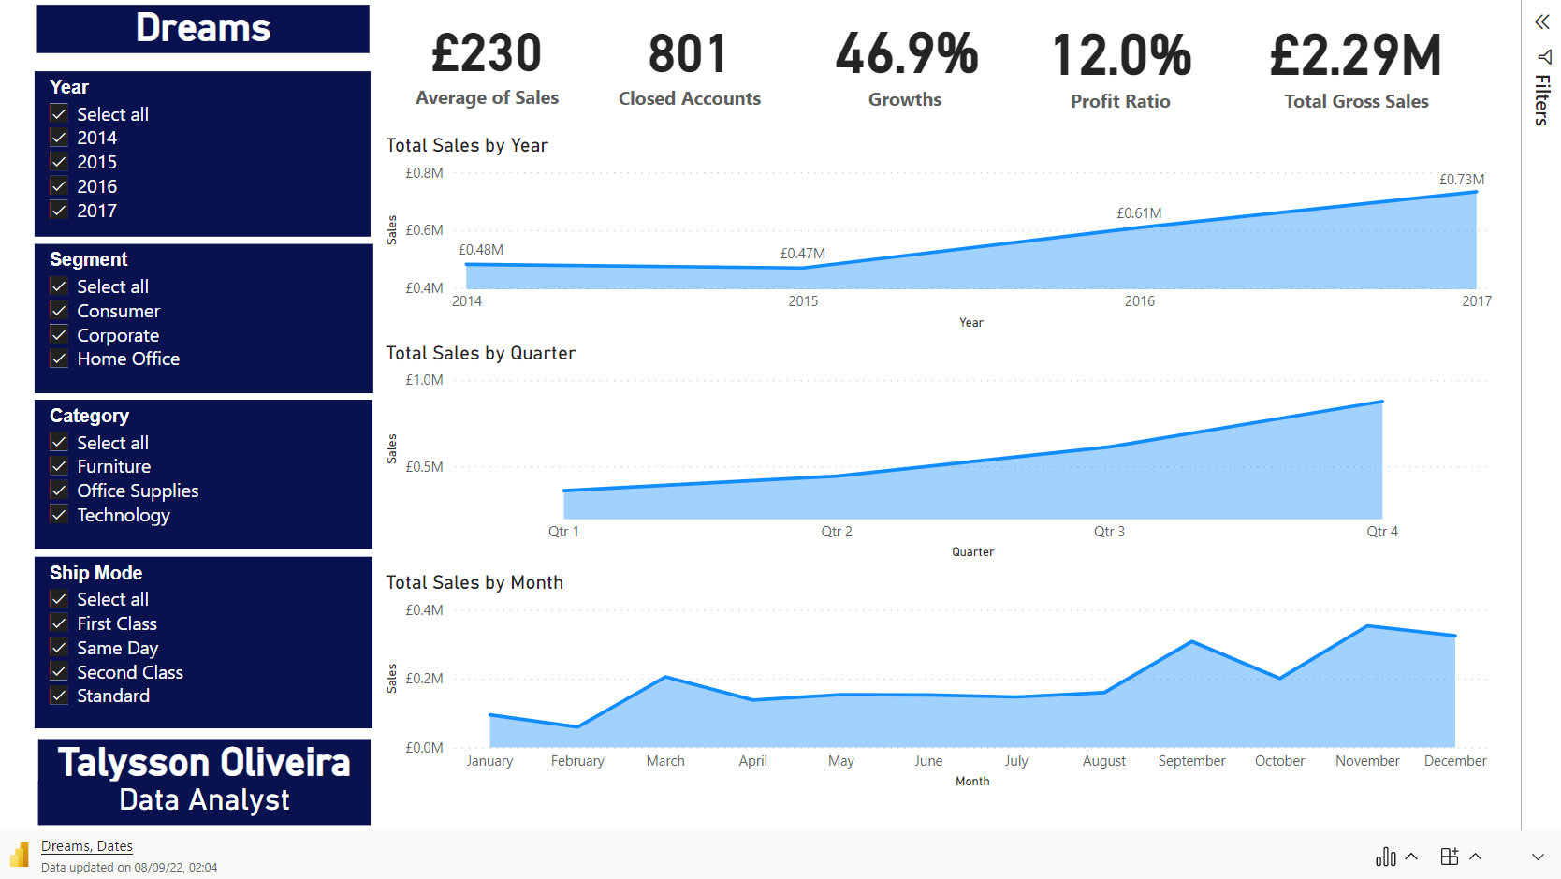

Slide 18
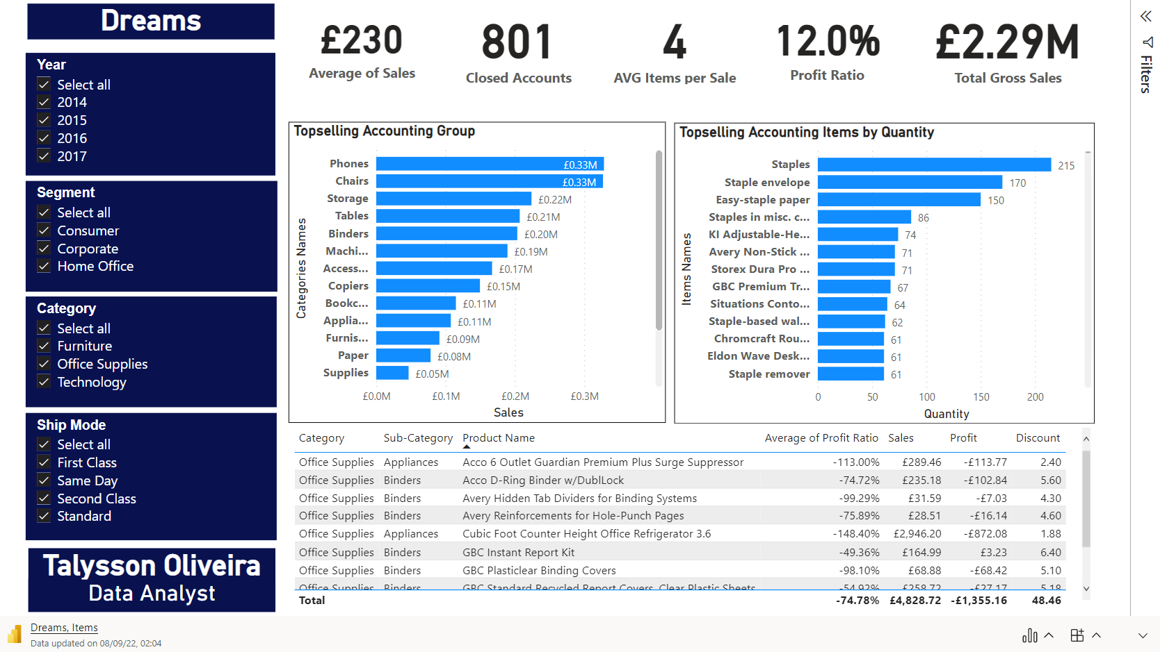

Slide 19
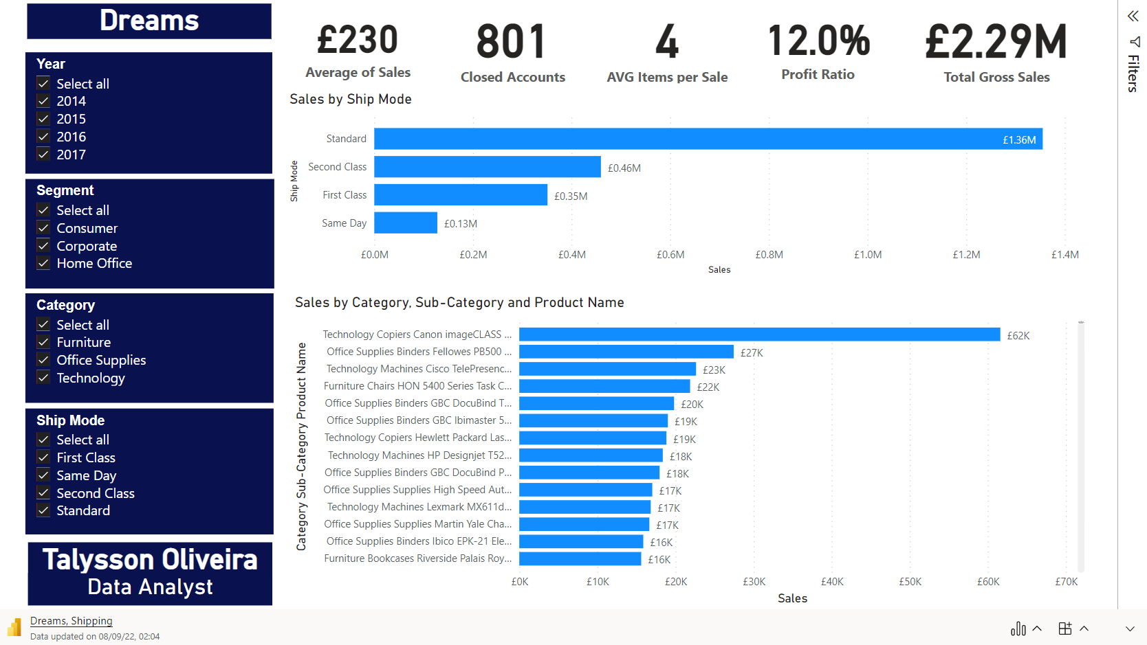

Slide 20
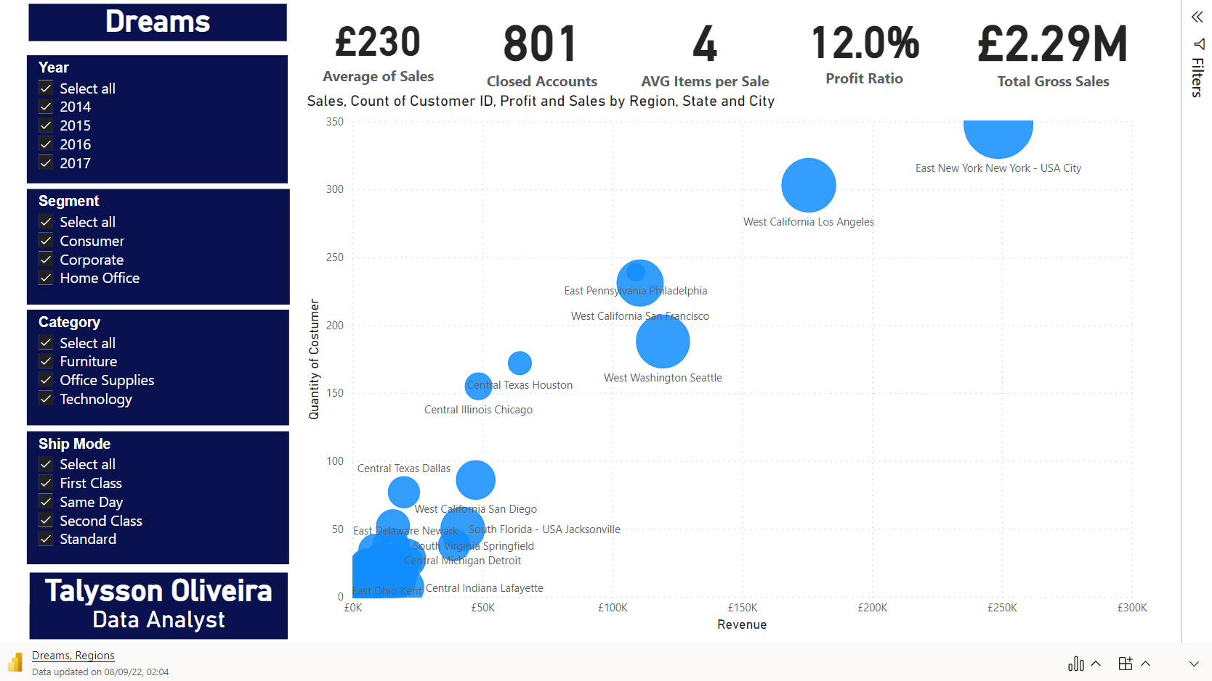

Slide 21

Conclusion
As we've covered in this presentation, various characteristics should be evaluated to be able to take the best action to identify trends in sales and implementing a data warehouse. Armed with the necessary tools, we can get a clear picture of the size of the product we should focus on next.
With slices, filters and clear graphs, we can visualise what the report is showing us so we can take action to make the right decision. We can also visualise the growth of the company during this period and see which outlets sell the most, which products sell the most, and which products have the highest added value. Then came predictions.
Consider that certain items should be kept in the portfolio due to client preference, or because competition also applies to these particular items, or simply because they can attract more clients, and removing those items the profit might increase significantly.
Another factor is that we can't measure profit without cost value, which makes it difficult to make a decision because we can't extract much information from it just by the number of sales and the total value.

Slide 22


Talysson Oliveira
Data Analyst / Data Engineering
Talyssonsoliveira@gmail.com

